Slide 1
From NOGAPS to NAVGEM 1.1 in GOFS: A Progress Report
Main performers:
Joe Metzger, Alan Wallcraft (NRL)
Ole Martin Smedstad, Debbie Franklin (QNA)
Brief to NAVOCEANO
26 June 2013

Slide 2
NAVGEM 1.1 replacing NOGAPS
NAVGEM 1.1 was declared operational on 13 Mar 2013
NOGAPS to be decommissioned 31 Aug 2013
Preliminary analysis shows the two atmospheric models are different enough to cause a different upper ocean model response
Two calibrations must be performed on NAVGEM 1.1 output to assure the underlying ocean model response will be consistent across the decommission time boundary
  Calibrate NAVGEM winds to scatterometer winds
  Calibrate heat flux relative to forecast SST error

Slide 3
NAVGEM 1.1 Wind Calibration
Obtain one year of NAVGEM 1.1 output: Jun 2012 through May 2013
  Hindcast output (Jun 2012 – Jan 2013) processed and in HYCOM-ready format
  Pre-OPS/OPS output (Dec 2012 →) processed daily and in HYCOM-ready format
Regression analysis vs. contemporaneous scatterometer data (SSMI/S and WindSAT)
  Contemporaneous scatterometer data obtained
  Regression analysis completed
Calibrate NAVGEM 1.1 wind speed

Slide 4
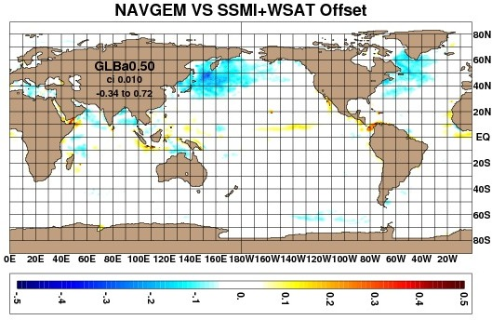
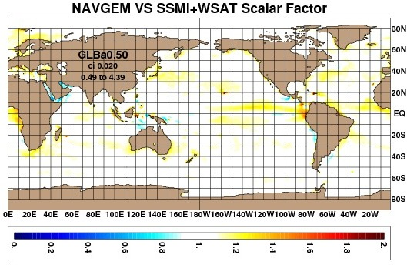
Regression Offset and Scaling Factor

Slide 5
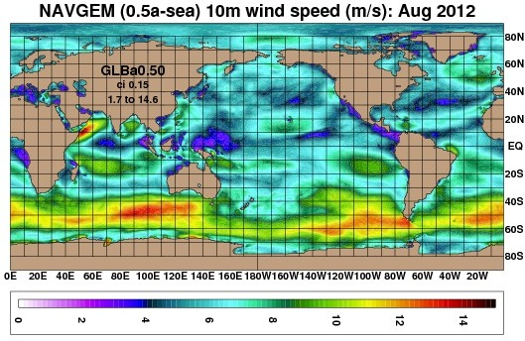
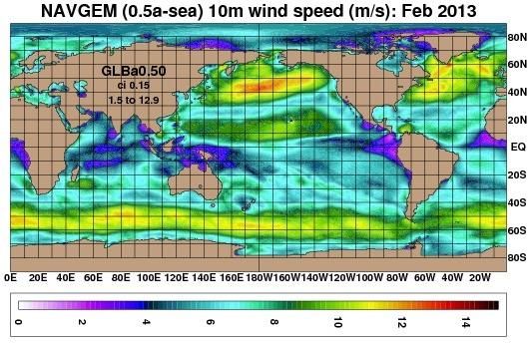
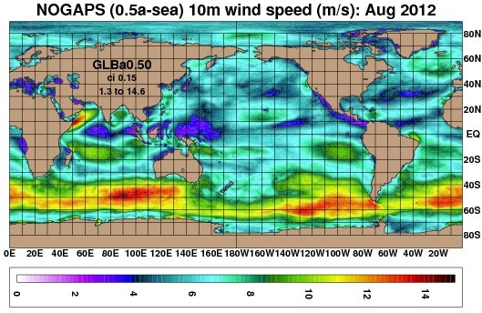
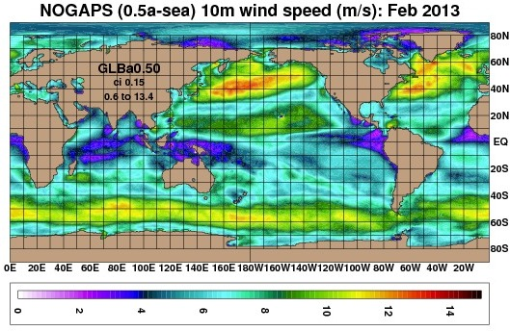
Monthly Wind Speed
Before scatterometer calibration

Slide 6
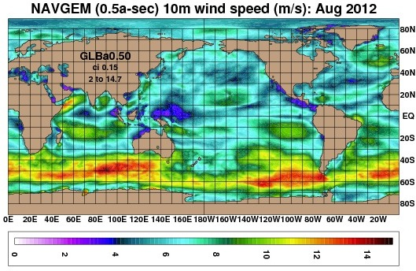
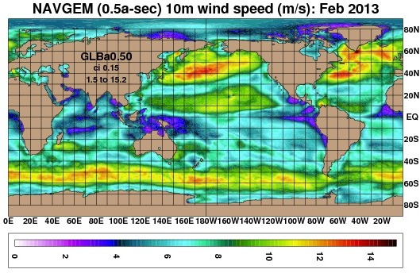
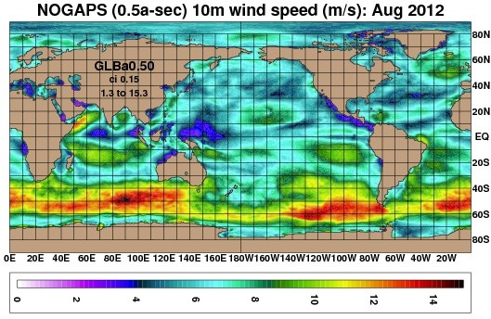
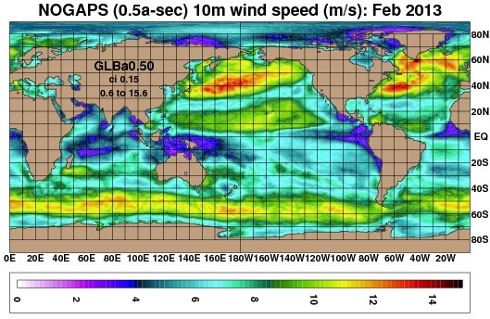
Monthly Wind Speed
After scatterometer calibration

Slide 7
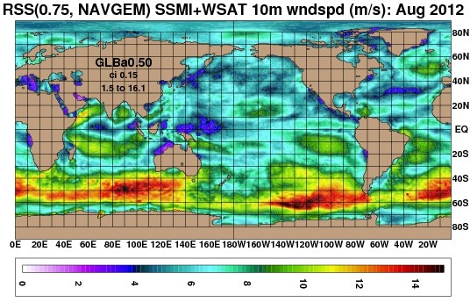
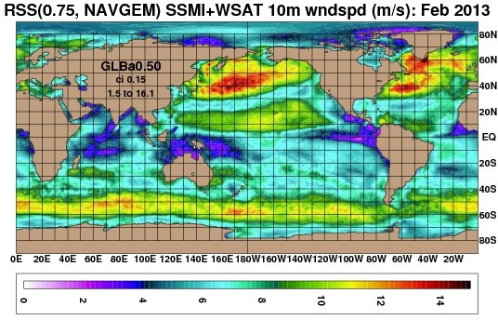
Monthly Wind Speed
After scatterometer calibration
RSS = Remote Sensing Systems scatterometer

Slide 8
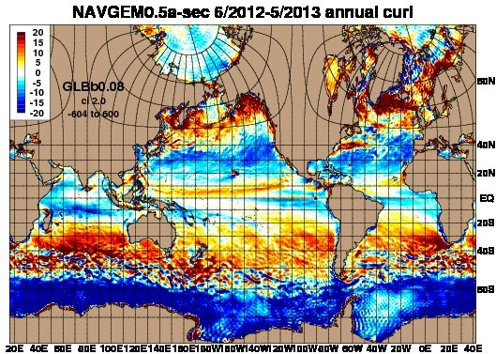
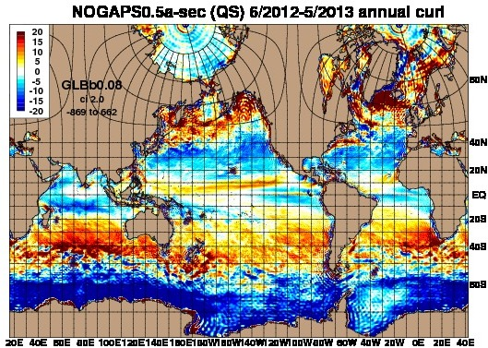
Annual Wind Curl - Global
After scatterometer calibration
It is not obvious at this scale, but the NAVGEM curl field is far less noisy than NOGAPS

Slide 9
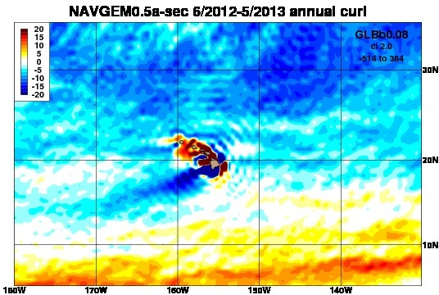
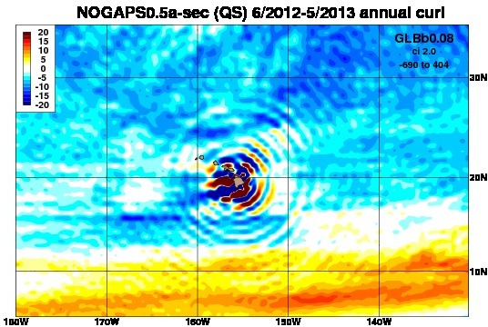
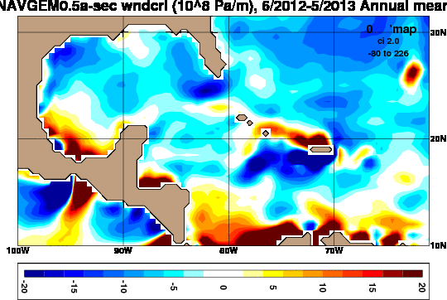
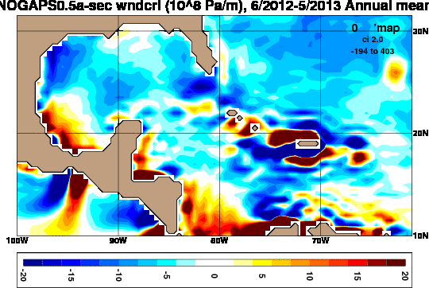
Annual Wind Curl
After scatterometer calibration

Slide 10
NAVGEM 1.1 Surface Fields
With a year of NAVGEM 1.1 output, we compared monthly mean output with contemporaneous NOGAPS and NCEP CFSV2 output
Highlight differences between various surface fields
  2 m air temperature, net surface shortwave radiation, 2 m specific humidity, ground-sea temperature
  June and December 2012 shown
Perhaps these differences are expected due to the improved physics in NAVGEM 1.1 , but they will have a significant impact on the upper ocean (ice) response within HYCOM (CICE) that we must take into account

Slide 11
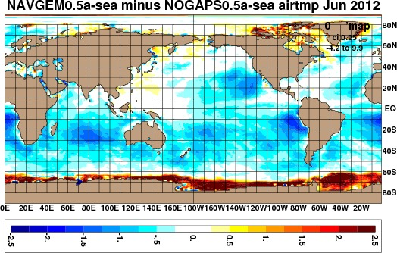
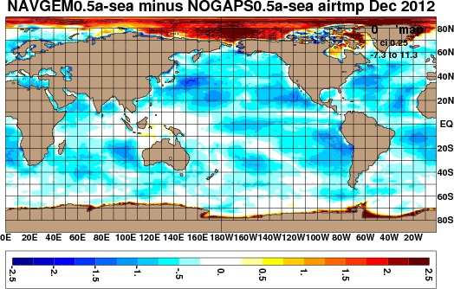
NAVGEM 1.1 minus NOGAPS
Monthly 2 m air temperature difference (°C)
NAVGEM is generally colder than NOGAPS over the ocean,
but warmer over ice in the winter hemisphere (however, temps are still very cold)

Slide 12
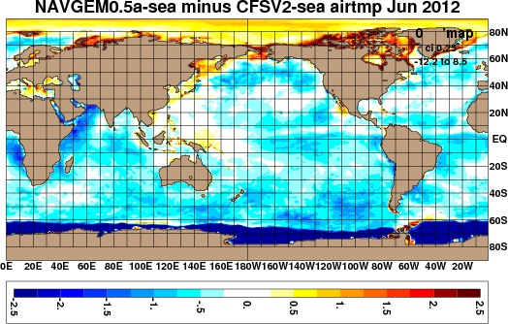
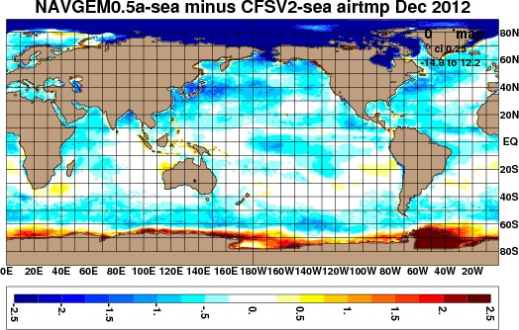
NAVGEM 1.1 minus CFSV2
Monthly 2 m air temperature difference (°C)
NAVGEM is also colder than CFSV2 over the ocean and
colder over ice in the winter hemisphere

Slide 13
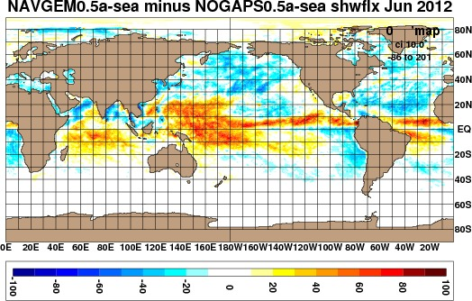
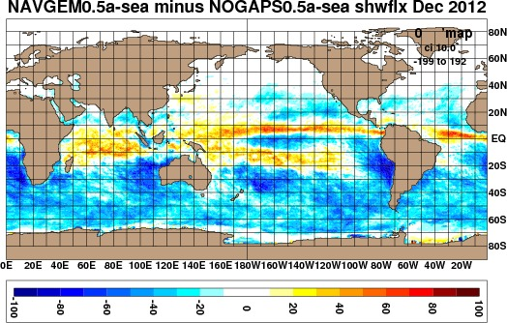
NAVGEM 1.1 minus NOGAPS
Monthly net surface shortwave radiation difference (W/m²)

Slide 14
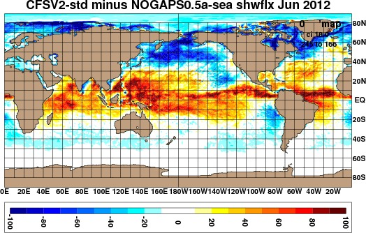
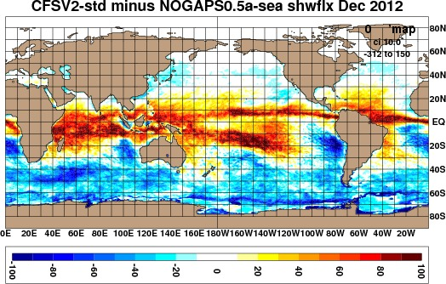
CFSV2 minus NOGAPS
Monthly net surface shortwave radiation difference (W/m²)
CFSV2 shows similar patterns relative to NOGAPS
albeit a stronger pattern

Slide 15
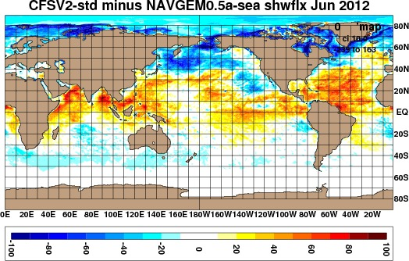
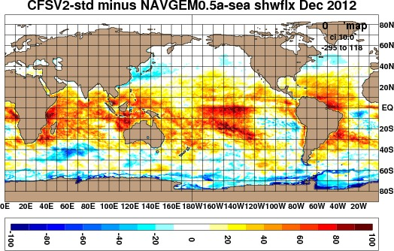
CFSV2 minus NAVGEM 1.1
Monthly net surface shortwave radiation difference (W/m²)
NAVGEM has weaker surface shortwave radiation than CFSV2
throughout the tropics and mid-latitudes; differences routinely exceed 50 W/m²

Slide 16
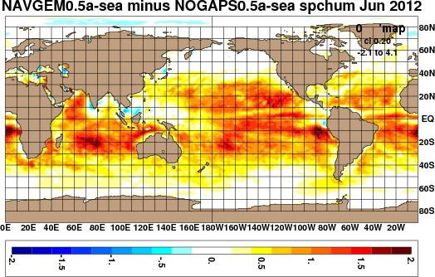
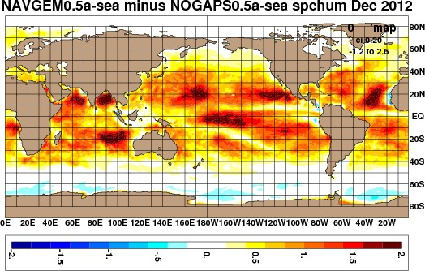
NAVGEM 1.1 minus NOGAPS
Monthly 2 m specific humidity difference (g/kg)
NAVGEM has a moister lower boundary layer than NOGAPS
throughout the tropics and mid-latitudes; values of 1 g/kg are ~10% of total signal

Slide 17
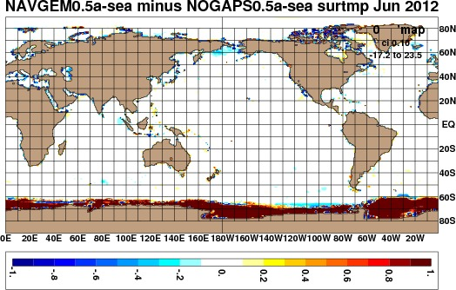
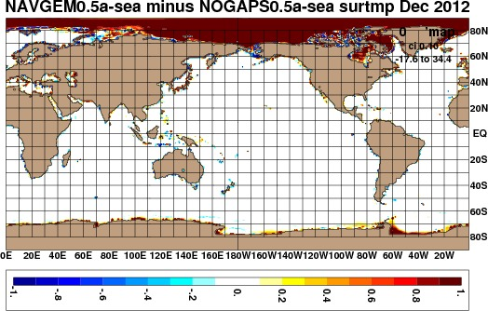
NAVGEM 1.1 minus NOGAPS
Monthly ground-sea temperature difference (°C)
Ocean surface analysis is consistent between NAVGEM and NOGAPS,
but NAVGEM has a warmer ice temperatures than NOGAPS

Slide 18
NAVGEM 1.1 Heat Flux Calibration
Using scatterometer-calibrated NAVGEM 1.1 winds, integrate a June 2012-May 2013 GOFS hindcast
As this moves forward, integrate a series of 5-day forecasts
  Do this every 2nd day to provide ~15 forecasts/month
  Compute SST error against verifying GOFS analyses
  Compute heat flux offset for each month
  Apply 1-2-1 running temporal filter to monthly offsets

Slide 19
Hindcast to Real-time
Re-integrate the June 2012-May 2013 GOFS hindcast using calibrated NAVGEM 1.1 winds and monthly varying heat flux offset
  This can be started as soon as the first filtered monthly offset files become available
Will need to get this hindcast to real-time in order to hand off to NAVOCEANO
This will be done with the existing GOFS 3.01 configuration, i.e. GLBa0.08, energy-loan ice, 32 layers

Slide 20
Hindcast Schematic
June
2012
Hindcast with NAVGEM 1.1 scatterometer-scaled winds (GLBa0.08-27.0)
May
2013
As the above hindcast is running:
Each month run multiple 5-day forecasts every other day (with NAVGEM scatterometer-scaled winds) → ~15 samples/month (GLBa0.08-27.1)
Compute monthly SST error against verifying analysis → monthly heat flux offset
Monthly heat flux offsets may be a bit noisy so apply a 1-2-1 running time filter
Hindcast with NAVGEM 1.1 scatterometer-scaled winds & monthly varying offset (GLBa0.08-27.2)
June
2012
Real-
time
This second hindcast can start as soon as the first 1-2-1 time filtered heat flux offset is available
Every third month, repeat 5-day forecasts using heat flux offset to examine the impact on forecast SST error (GLBa0.08-27.3)
Second hindcast has to be brought up to real-time by 15 Aug 2013 (as GOFS 3.02)
  NAVOCEANO wants to run two weeks of dual OPS

Slide 21
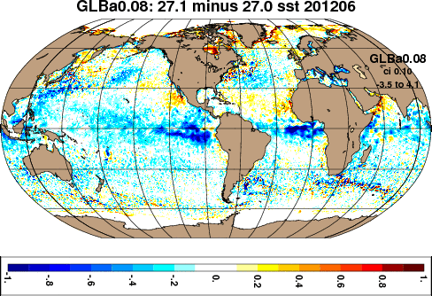
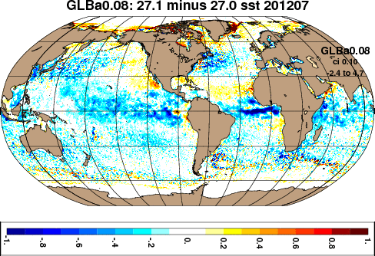
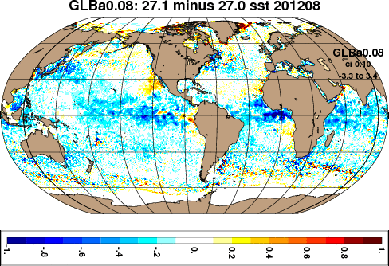
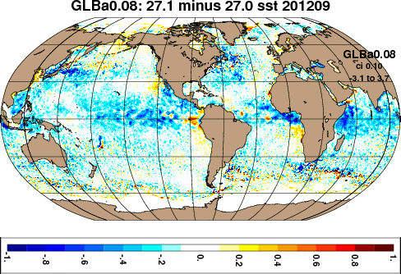
Monthly 5-day Forecast SST Error
(5-day forecast minus verifying GOFS analysis)
YYYYMM

Slide 22
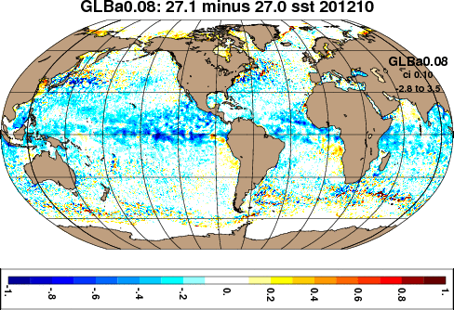
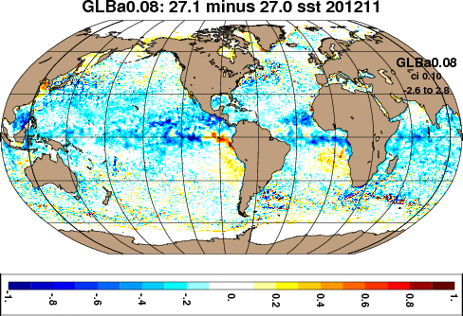
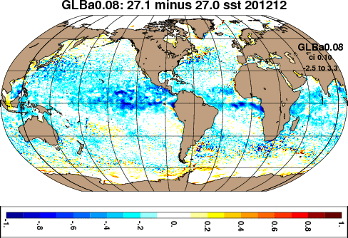
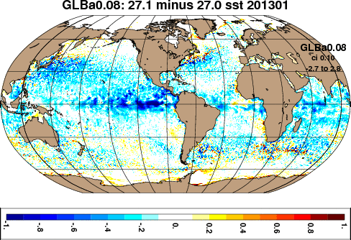
Monthly 5-day Forecast SST Error
(5-day forecast minus verifying GOFS analysis)

Slide 23
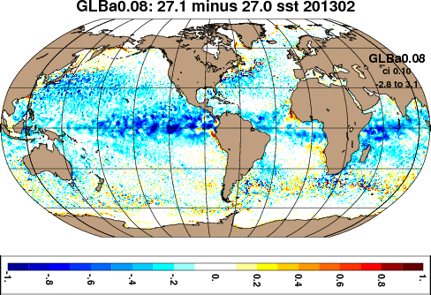
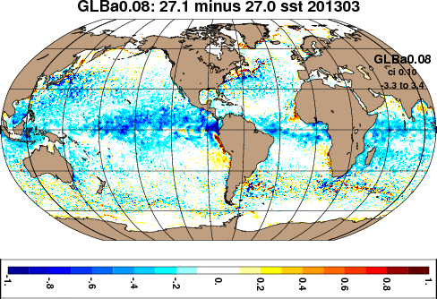
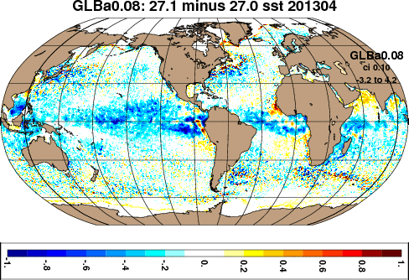
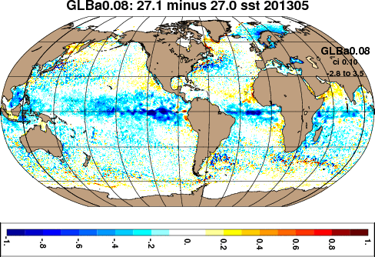
Monthly 5-day Forecast SST Error
(5-day forecast minus verifying GOFS analysis)

Slide 24
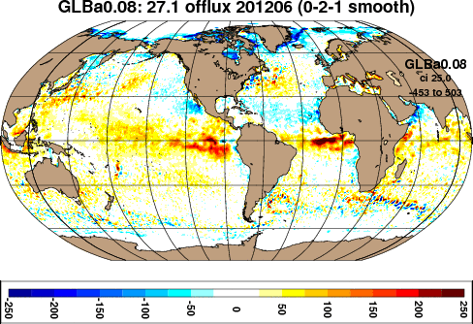
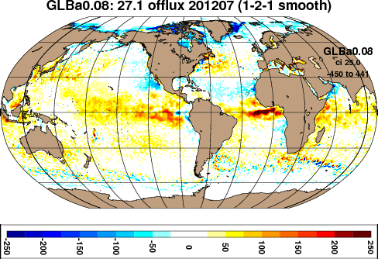
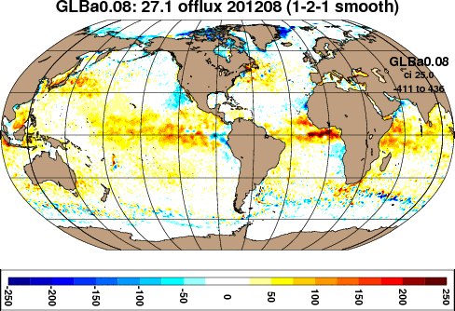
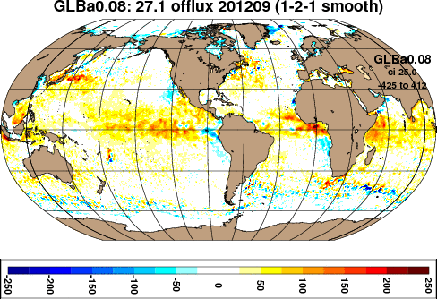
Monthly 1-2-1 Filtered Heat Flux Offset
(Based on 5-day forecast SST error)

Slide 25
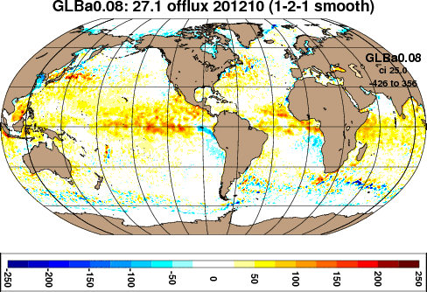
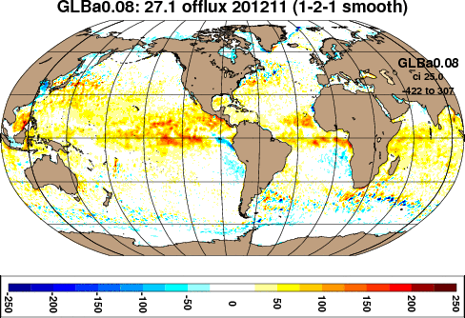


Monthly 1-2-1 Filtered Heat Flux Offset
(Based on 5-day forecast SST error)

Slide 26




Monthly 1-2-1 Filtered Heat Flux Offset
(Based on 5-day forecast SST error)

Slide 27

Monthly 5-day Forecast SST Error
Before applying heat flux offset
After applying heat flux offset
Left: 5-day forecast SST error from first hindcast (no offset applied)
Right: 5-day forecast SST error from second hindcast (offset applied)
There is a significant reduction in global 5-day forecast SST error after applying heat flux offset to both the hindcast and the forecasts
  Error is generally less than a few tenths of a degree Celsius
The June 2012 correction is on the “training” output, the real test will be June 2013

Slide 28

Monthly 5-day Forecast SST Error
Before applying heat flux offset
After applying heat flux offset
Left: 5-day forecast SST error from first hindcast (no offset applied)
Right: 5-day forecast SST error from second hindcast (offset applied)
There is a significant reduction in global 5-day forecast SST error after applying heat flux offset to both the hindcast and the forecasts
  Error is generally less than a few tenths of a degree Celsius

Slide 29

Monthly 5-day Forecast SST Error
Before applying heat flux offset
After applying heat flux offset
Left: 5-day forecast SST error from first hindcast (no offset applied)
Right: 5-day forecast SST error from second hindcast (offset applied)
There is a significant reduction in global 5-day forecast SST error after applying heat flux offset to both the hindcast and the forecasts
  Error is generally less than a few tenths of a degree Celsius

Slide 30

Monthly 5-day Forecast SST Error
Operational GOFS – NOGAPS forced
Hindcast GOFS – NAVGEM forced
Left: 5-day forecast SST error from operational GOFS 3.01
  Annual heat flux offset
Right: 5-day forecast SST error from second NAVGEM forced hindcast
  Monthly varying heat flux offset
Smaller 5-day forecast SST error in NAVGEM forced GOFS

Slide 31




Monthly 5-day Forecast Ice Concentration Error
(5-day forecast minus verifying HYCOM analysis)
Significant summer
hemisphere ice melt
in the 5-day forecast
in the Arctic (and
Antarctic)
Remember: This is energy-loan ice model, NOT CICE
Not a problem in the
late fall/winter
hemisphere

Slide 32




Monthly 1-2-1 Filtered Heat Flux Offset

Slide 33

Monthly 5-day Forecast Ice Concentration Error
(5-day forecast minus verifying HYCOM analysis)
Before applying heat flux offset
After applying heat flux offset
Left: 5-day forecast ice error from first hindcast (no offset applied)
Right: 5-day forecast ice error from second hindcast (offset applied)
Even after application of heat flux offset, still see significant ice reduction in the 5-day forecast
  SST-based heat flux offset not optimal in ice covered regions
  Problematic in both Arctic and Antarctic during summer
For the ACNFS switchover to NAVGEM, we are investigating forecast ice error more thoroughly

Slide 34
ACNFS Transition to NAVGEM 1.1 Forcing
Integrate a June 2012 → present hindcast of ACNFS with NAVGEM scatterometer-scaled winds and monthly varying heat flux offset derived from GOFS
  This has commenced and is in July 2012
Each month additionally generate 5-day forecasts and compare against NOGAPS forced pre-operational ACNFS

Slide 35


Monthly 5-day Forecast Ice Concentration Error
(5-day forecast minus verifying HYCOM analysis)
Pre-operational ACNFS
NOGAPS forced
Hindcast ACNFS
NAVGEM forced
Hindcast GOFS
NAVGEM forced
Left: Pre-operational ACNFS, CICE model, annual heat flux offset
Middle: Hindcast ACNFS being spun up to real-time, CICE model, monthly varying heat flux offset derived from global model
Right: Second GOFS hindcast, energy loan ice model, monthly varying heat flux offset
Significantly lower forecast ice error in ACNFS compared to GOFS

